Slide 1


Graphics Design Fundamentals
Learn more: https://www.usertesting.com/blog/gestalt-principles

Slide 3
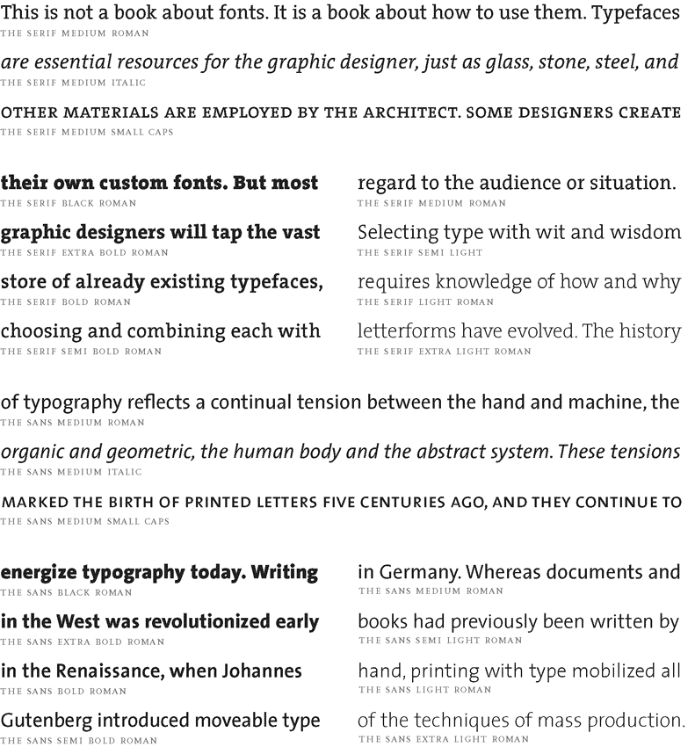
Working
with Text
Learn more: http://thinkingwithtype.com/letter/

Slide 4
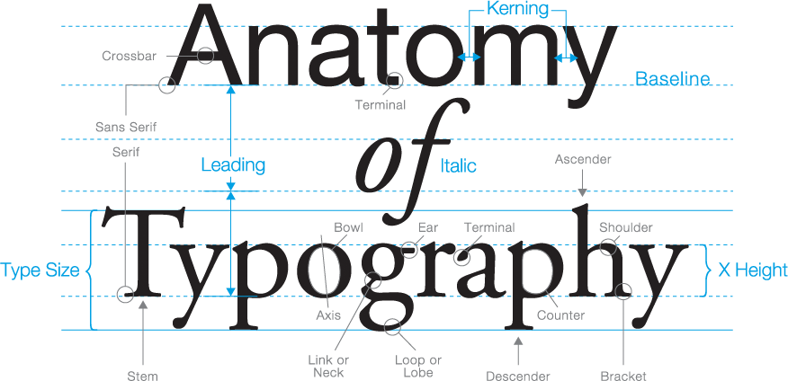

Slide 5
Tips to get started
USE ONE TYPEFACE
At least until you become more familiar with type. Do not use two typefaces of the same classification together
Helvetica Avenir
Courier Garamond
Rockwell
DOUBLE FONT SIZES
As a rule of thumb, you double the point size. For example, if you are using 30pt for the heading. Use 15pt for the body.
Heading
Some simple body text
SKIP A WEIGHT
Add contrast by mixing different font weights. You can skip a weight for emphasis.
Slim & Bold

Slide 6
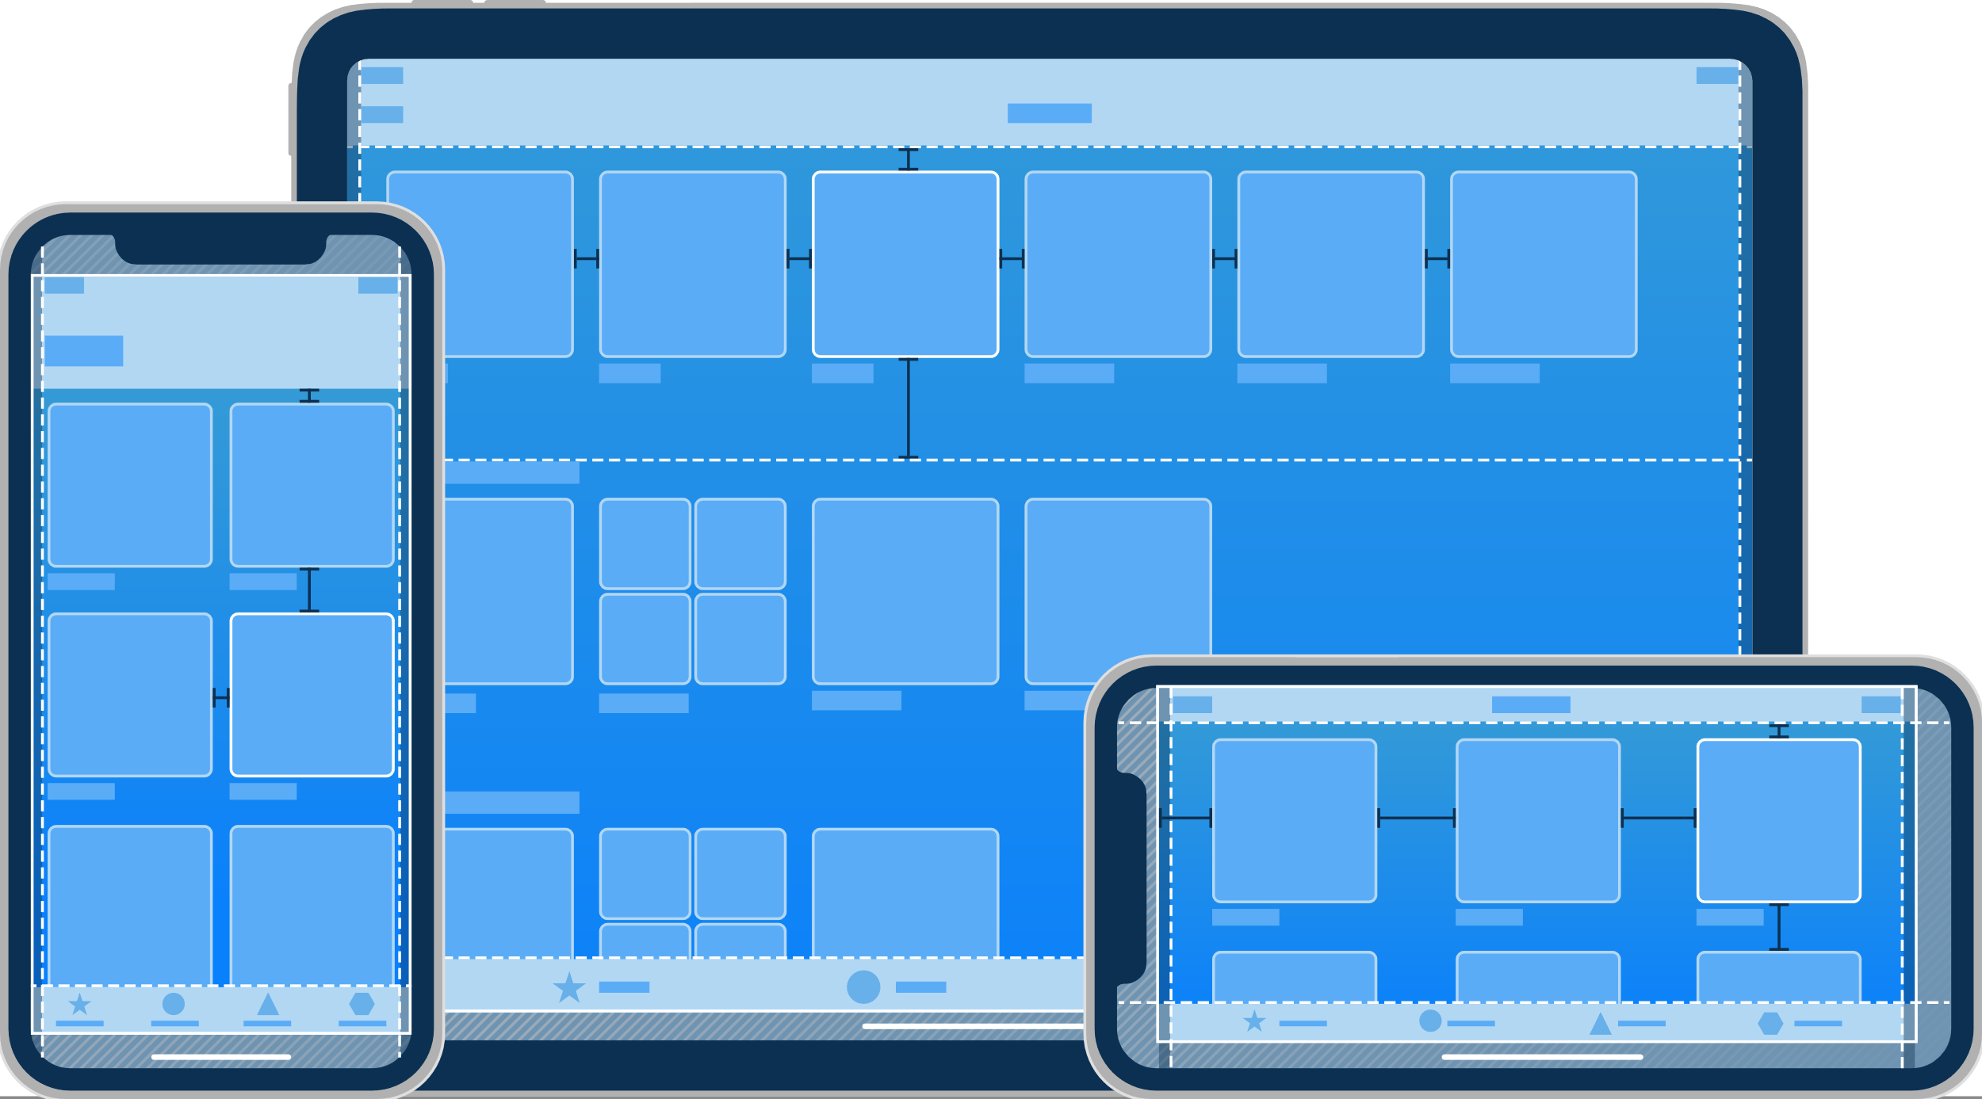
Layout and Hierarchy

Slide 7
Layout and Hierarchy

Slide 8
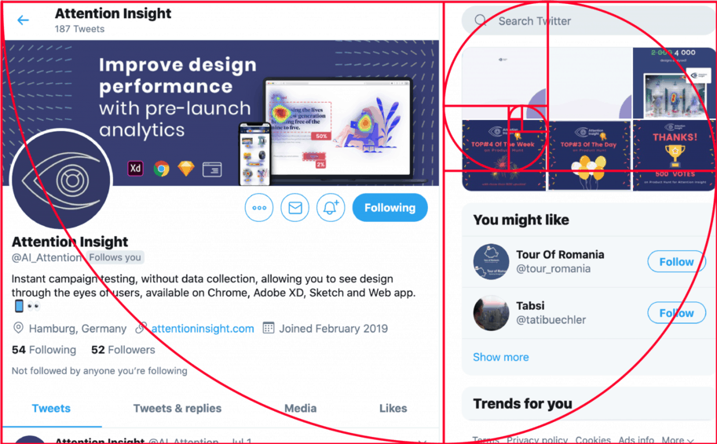
The Golden Ratio
1.61803…
Doug Bowman, Twitter’s creative director, on the new layout: “To anyone curious about #NewTwitter column proportions, know that we didn’t leave those ratios to chance http://flic.kr/p/8ETYM7”.

Slide 9
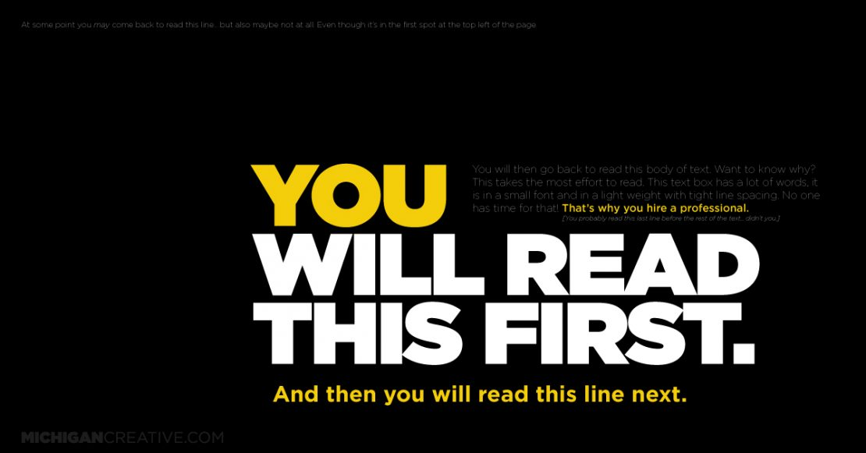

Slide 10
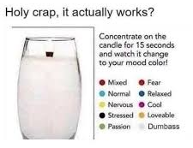

Slide 11
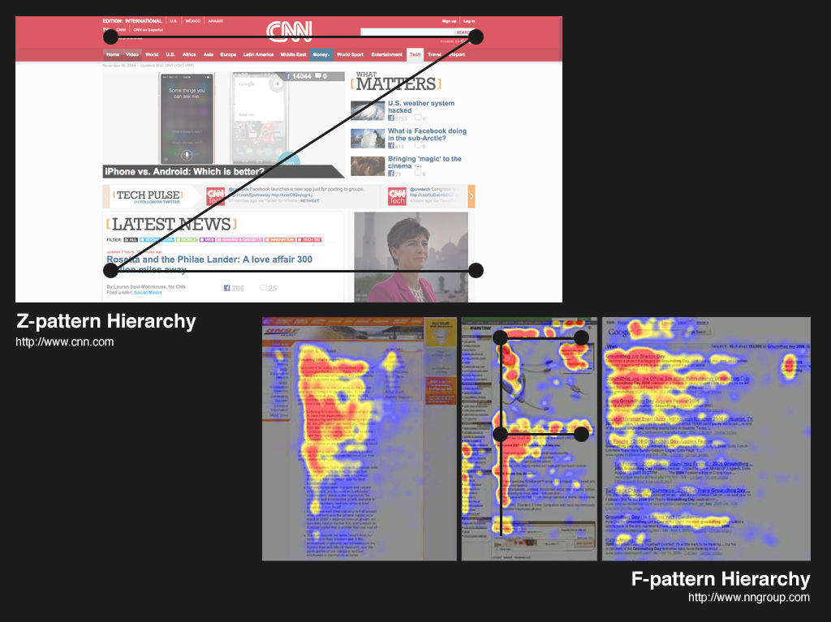

Slide 12
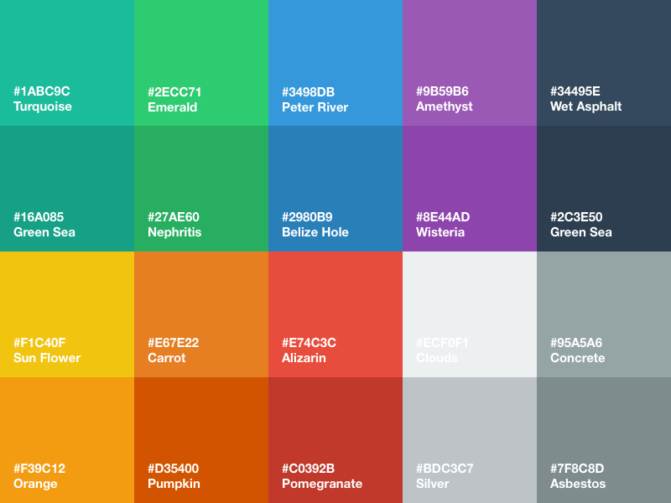
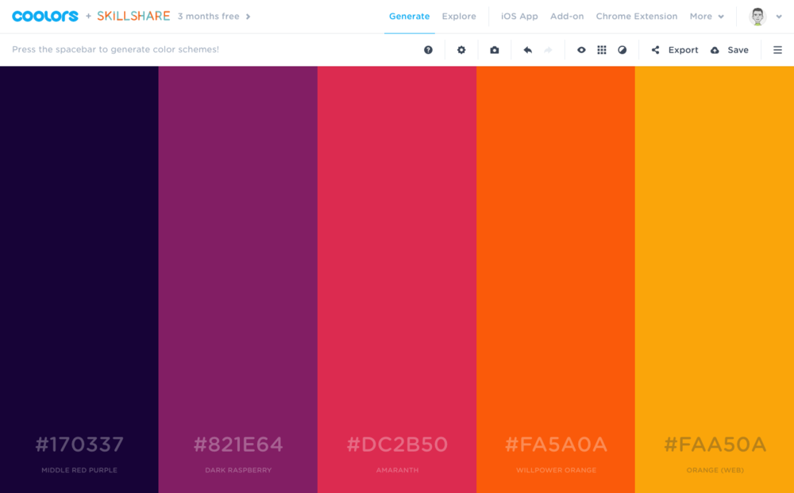
COLOR
Learn more: The meaning of colour

Slide 13
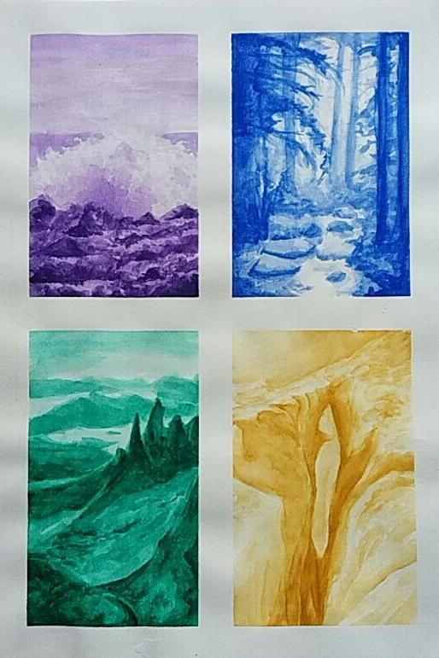
Resources
Colour Palette Generators
Generate - Coolors.co
Google Material Colour Tool (link)
Colour Palette collections
Happy Hues - Curated colors in context.
LOL Colors - Curated color palettes
Color palette | Adobe Color

Slide 14
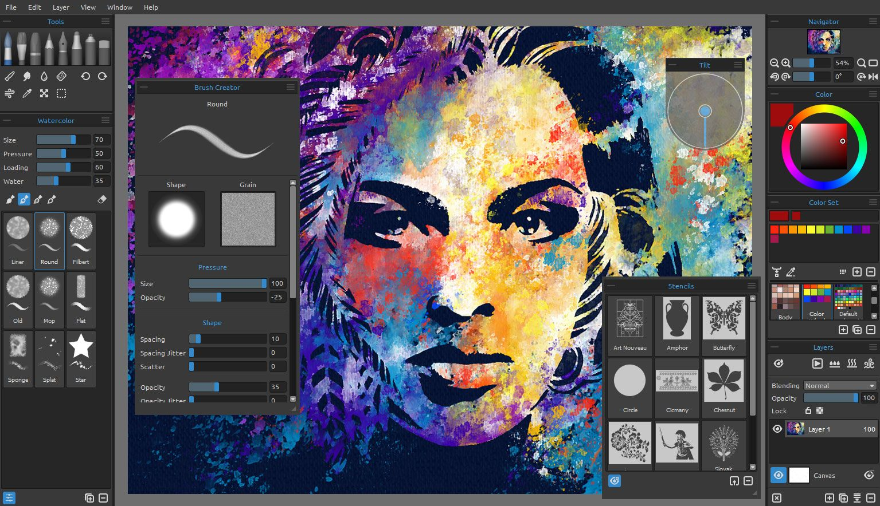

Slide 15
Freebies & Tools
Best design freebies from all over the Internet - AND CO collection
$0 Design Tools | Product Hunt
Freepik
Google Slides themes and Powerpoint templates | Slidesgo
Fontjoy - Generate font pairings in one click
Free Royalty Free Music — Fugue
Sinhala Keyboard Online LEXILOGOS >>
Storyset | Customize, animate and download illustration for free
Animista
Startup Stash - Curated resources and tools for startups

